Slide 1
Predicting Music Popularity
Austen, Luz, Jennie

Slide 2
Data Insights

Slide 3
Overview
17k+ rows
Spotify launched:
  2008 in Europe
  2011 in the US
Original date of release of songs in dataset
  1921-2020
19 columns
  Describes songs( danceability, energy, loudness, speechciness

Slide 4
Popularity Score Index by Spotify
Calculated by different factors: Streams, Engagement, Recency, Playlist Inclusions
Popularity score ranges from 0-100
  Score of 30-49: Track is gaining traction
  Score of 50 or above:
    Recommended to listeners with similar taste
    Considered popular
Notes:
Streams: The total number of times a song has been played.
Engagement: How often listeners save, share, or add your song to their playlists.
Recency: Newer streams tend to have more weight than older ones, reflecting current popularity trends.
Playlist Inclusions: Tracks featured in popular playlists tend to have higher scores.

Slide 5
OBJECTIVES
Which factors are most important for predicting popularity
  Speechiness (More Lyrics, the Better?)
  Tempo (Beats Per Minute / Speed of the Song)
  Loudness
  Track Length
Which Models Provide the best Accuracy

Slide 6
Important Averages
Year | 1977
Danceability | 0.54
Tempo | 117 BPM
Speechiness | 0.10
Liveness | 0.21
Loudness | -11.47 DB
Popularity | 31.43

Slide 7
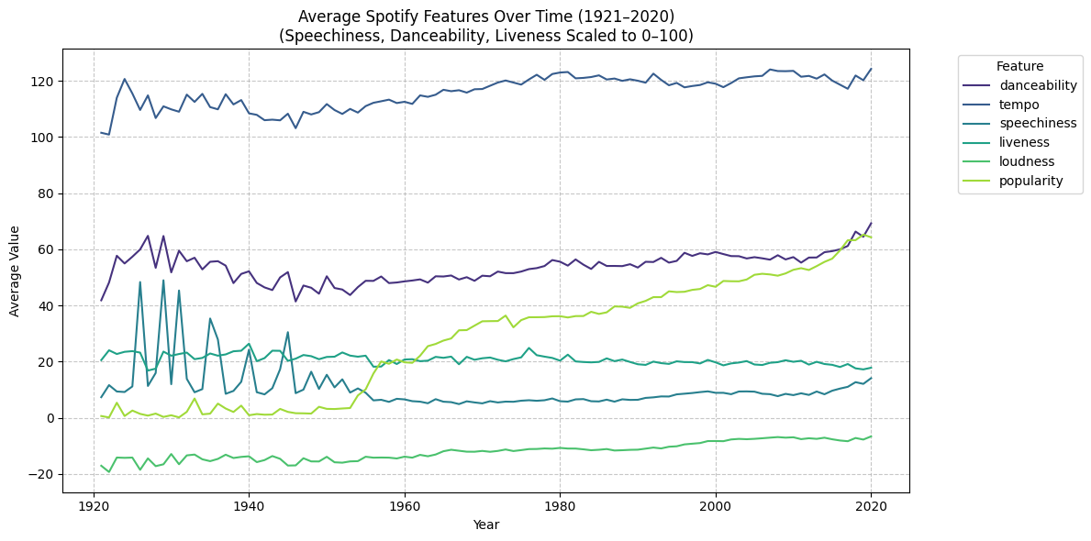
Important Averages Over Time

Slide 8
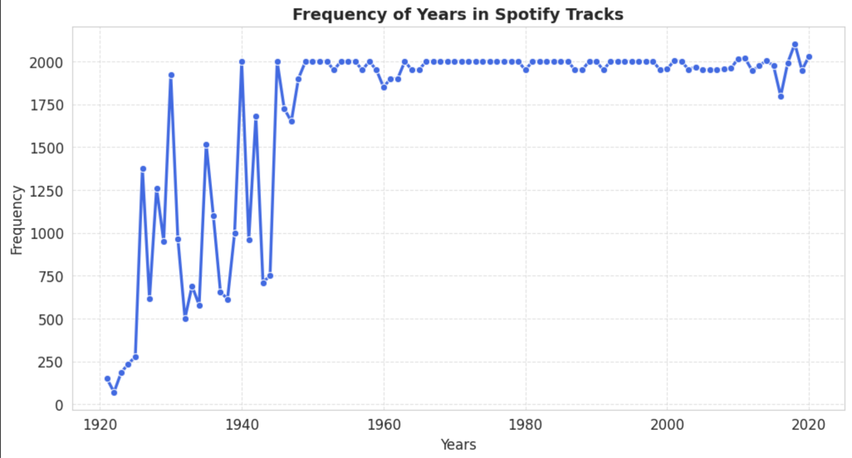
Frequency of Years(1921-2020) in Spotify Tracks

Slide 9
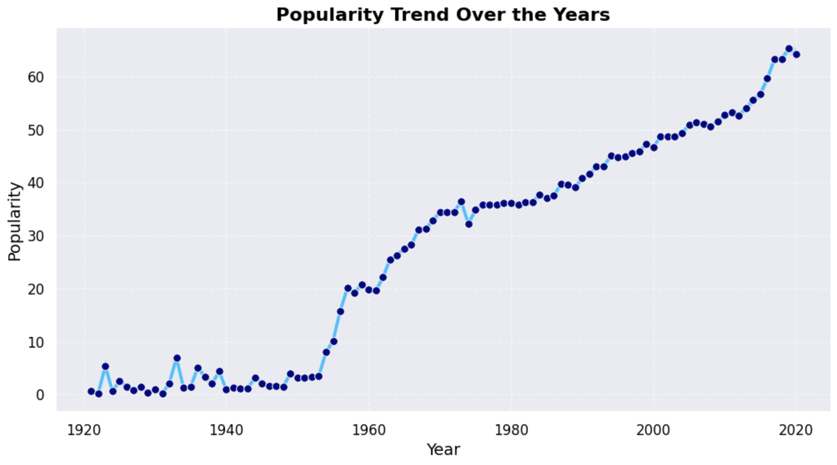
Popularity Through The Years

Slide 10
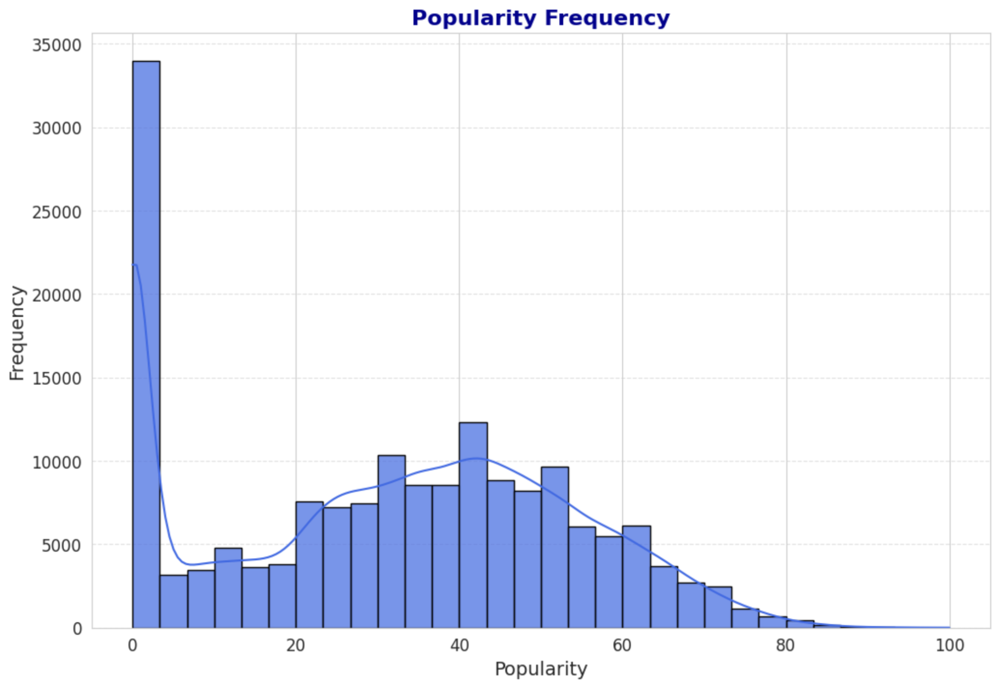
Popularity Frequency In Spotify Tracks
Mean: 31.43
Median : 33
16% of our data has popularity of zero
Why is that?

Slide 11
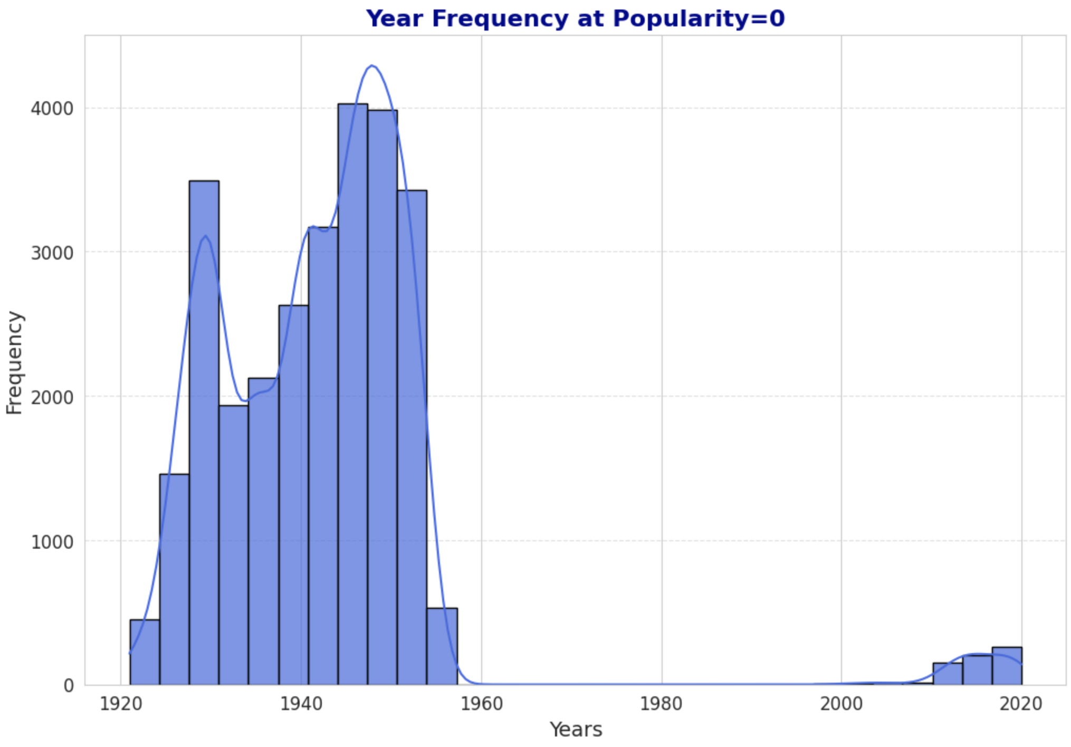
Year Frequency at Zero Popularity
Years 1921-1960
  98% in the zero pop dataset
  Older songs are less popular
  Spotify launched in 2011 in the US

Slide 12
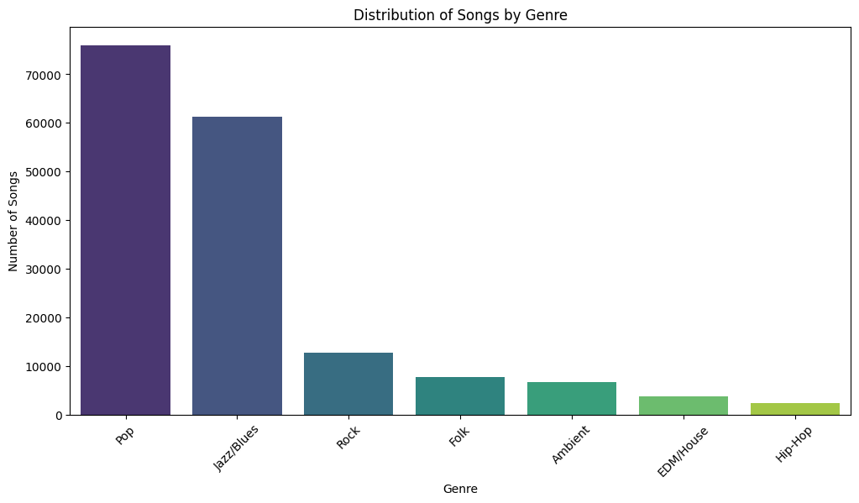
Genre Estimate

Slide 13
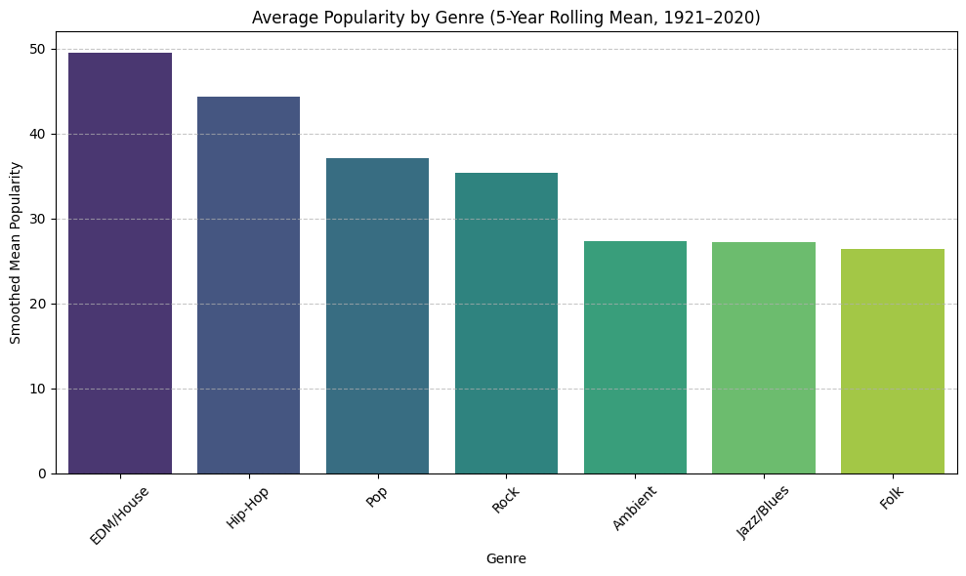
Average Popularity Of Each Genre
Pop
  Most frequent
  Why not the most popular?
  Has zero popularity songs

Slide 14
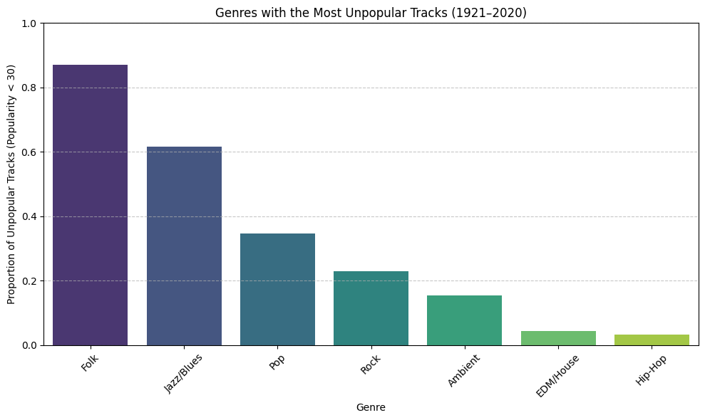
Genres Sorted by Below 30 Popularity

Slide 15
Modeling

Slide 16
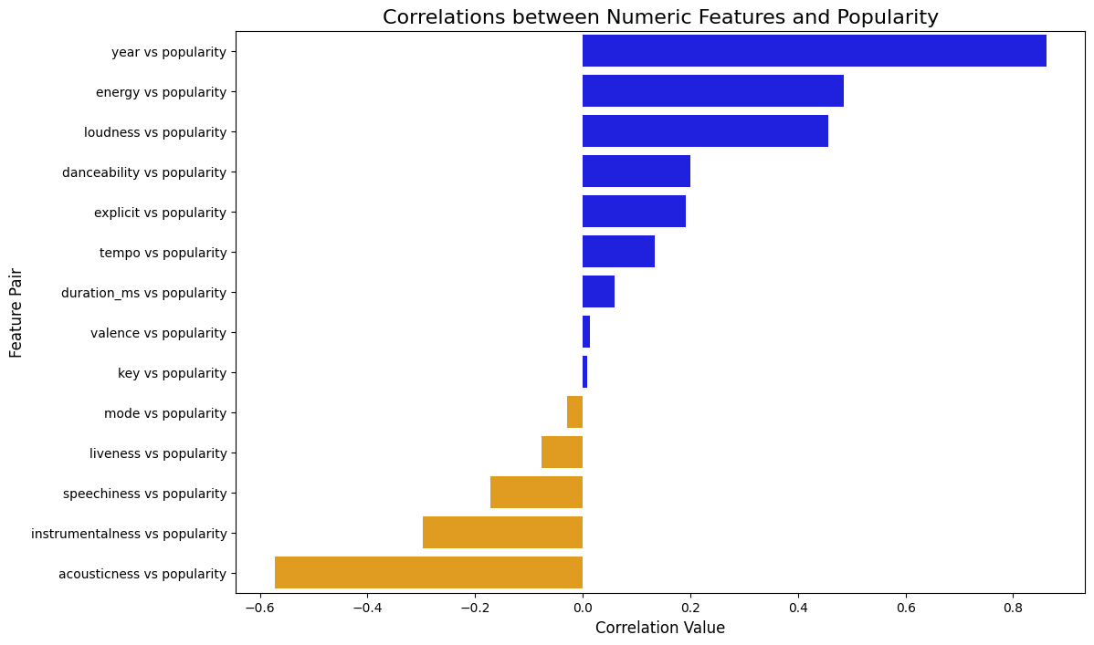
Correlations with Popularity

Slide 17
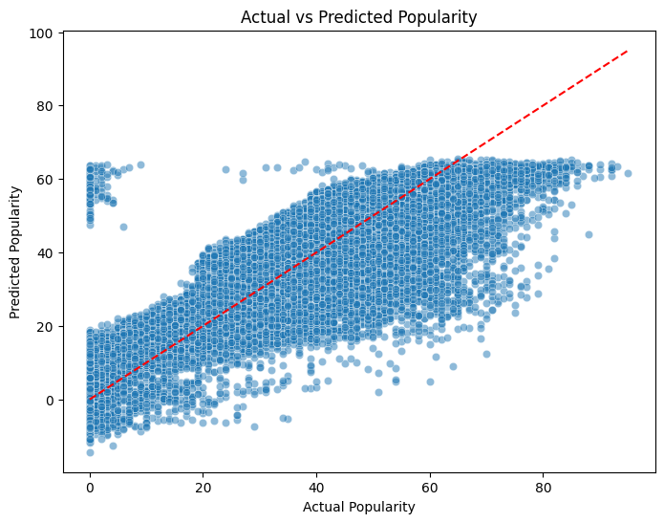
Linear Regression
Mean Absolute Error:
7.984
R-squared:
0.759
Root Mean Squared Error:
115.112

Slide 18
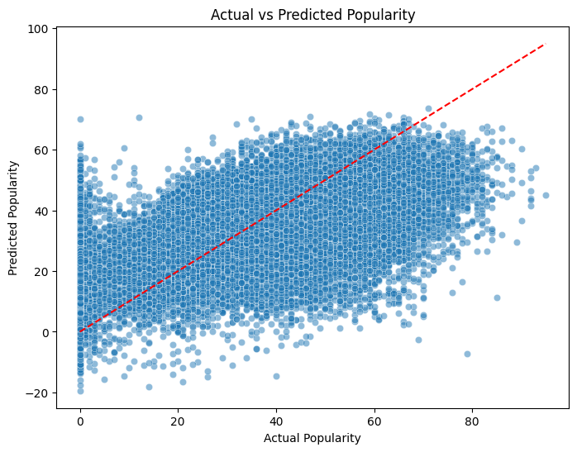
Linear Regression Without Year
Mean Absolute Error:
13.010
R-squared:
0.456
Root Mean Squared Error:
260.259

Slide 19
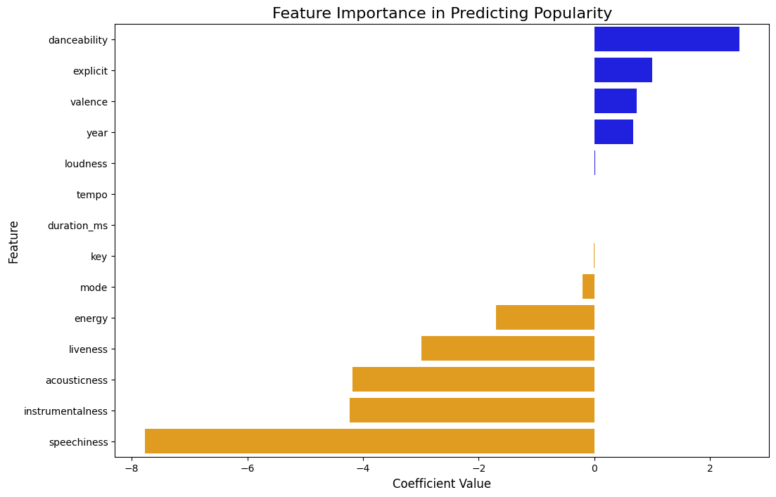
Linear Regression Features

Slide 20
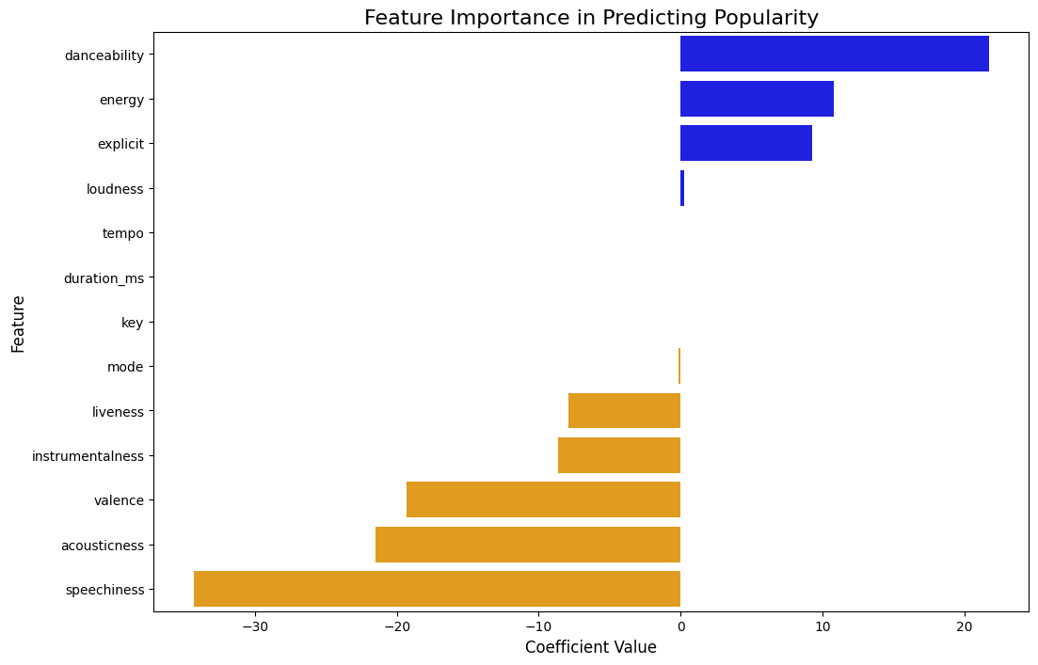
Linear Regression Features Without Year

Slide 21
Random Forest Regressor
Process:
  Step 1: Split data (80% train, 20% test).
  Step 2: Train a Random Forest with 100 trees.
  Step 3: Return the trained model and test set for evaluation.
Why Random Forest?
  Reduces overfitting.
  Handles complex relationships well.
  Provides feature importance insights

Slide 22
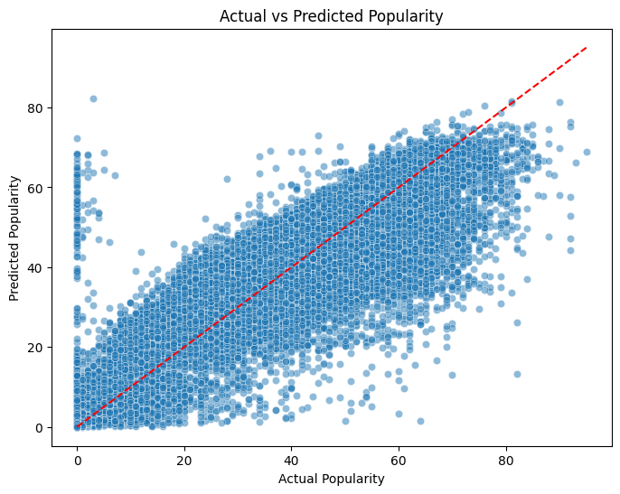
Random Forest Regressor
Mean Absolute Error:
6.749
R-squared:
0.809
Root Mean Squared Error:
91.220

Slide 23
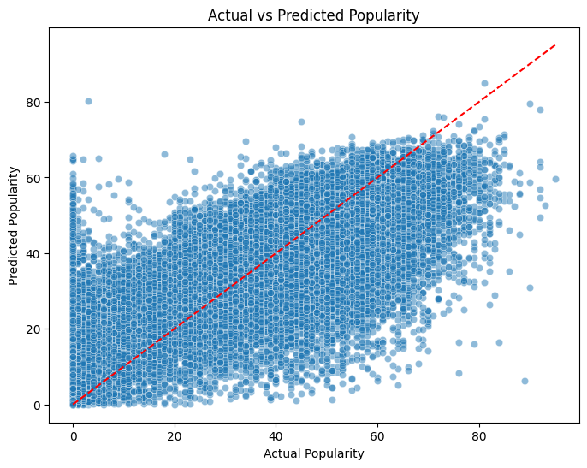
Random Forest Regressor Without Year
Mean Absolute Error:
10.391
R-squared:
0.605
Root Mean Squared Error:
188.798

Slide 24
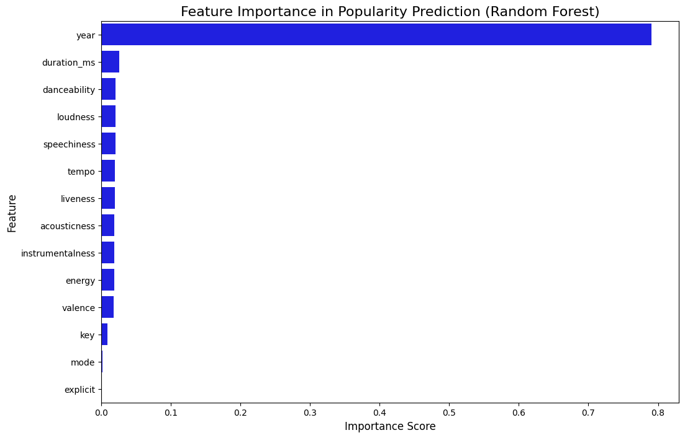
Random Forest Regressor Features

Slide 25
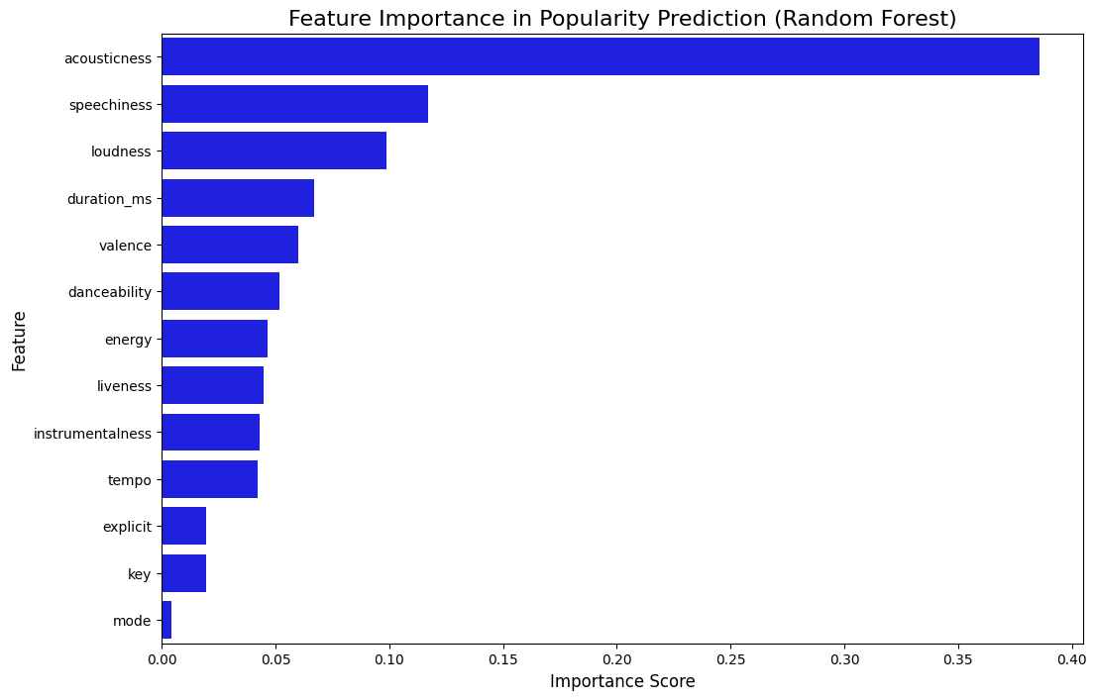
Random Forest Regressor Features Without Year

Slide 26
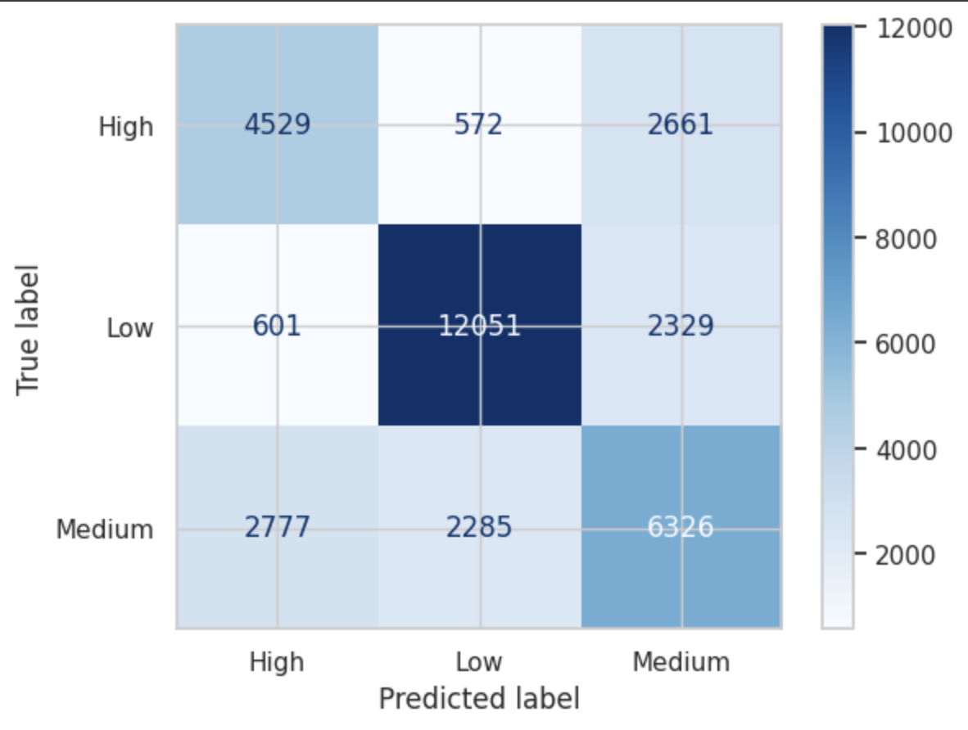
Decision Tree Classifier 3 bins
Split on pop milestone
Bins:
  0-29
  30-49
  50-100
Validation accuracy of:
  0.35
Testing accuracy of:
  0.67
HyperParameters:
  Splitter: random
  Random_state:100
Model w/o release year
  Validation accuracy
    0.36
  Testing Accuracy
    0.55

Slide 27
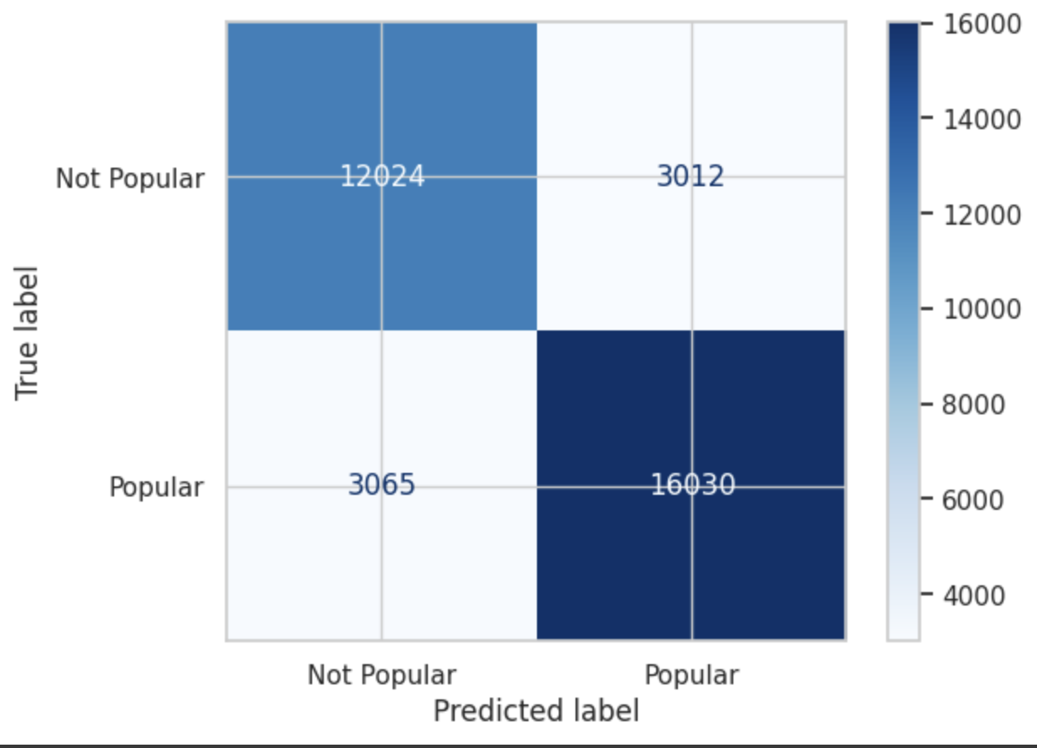
Decision Tree Classifier 2 bins
Split using kmeans
Popularity bins of:
  0-29
  30-100
Validation accuracy of:
  0.51
Test accuracy of :
  0.82
HyperParameters:
  Splitter: random
  random_state:100
Model w/o release year
  Validation accuracy
    0.51
  Testing Accuracy
    0.72

Slide 28

Logistic Regression 2 bins
Popularity bins of:
  0-29
  30-100
Validation accuracy of:
  Validation Accuracy of:
    0.784
  Test accuracy of :
    0.784
Model w/o release year
  Validation accuracy
    0.784
  Testing Accuracy
    0.783

Slide 29
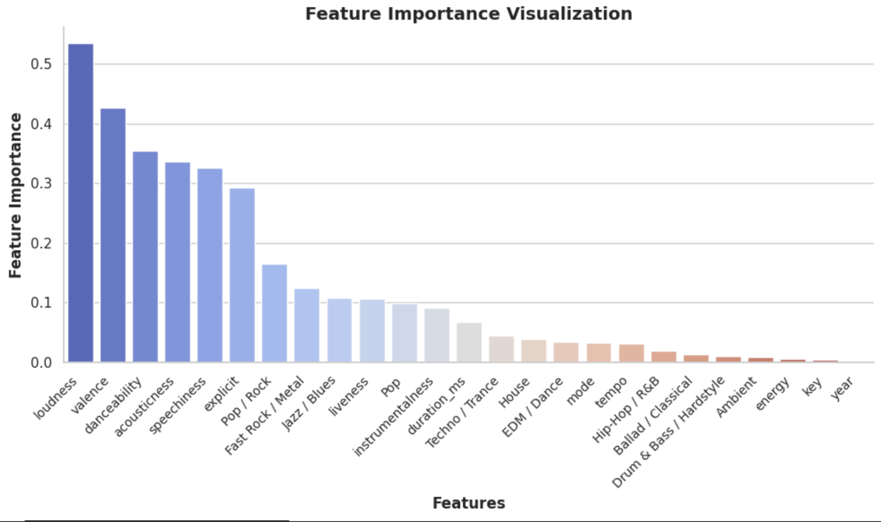
Feature Importance for Logistic Regression
Feature imp:
  Abs of model coef
Release Year
  <0.01
Loudness
  0.54
Valence
  0.43
Genre
  <0.2

Slide 30
Playlist For Song Recommendations
Subset of POP/Rock songs only
Sample of 1400 songs
Popularity
Max: 63
Min: 0
Mean: 35.70
Median: 35

Slide 31
Song Recommendations
FOR FINAL PRESENTATION!!

Slide 32
Predicting Popularity

Slide 33
The Take Aways

Slide 34
Conclusions
Best Model For Prediction Of Milestones
  Logistic Regression (~78% Accuracy)
  Important features :Loudness , valance, and danceability
Best Model for Predicting Specific Popularity:
  Random Forest Regressor (~ 6.74 Mean Absolute Error, R2~ 0.8)
Trends Seen Across Models:
  Release date year increases likelihood of accurate prediction
Take Away:
  Listeners are more likely to listen to newer songs
  Binning into popularity milestone predicts if a song will reach such event
  Regression model can predict a specific popularity score

